Slide 1
English Lesson: Verbs

Slide 2
Words we need / palavras que precisamos
a = um/uma
the = o/a, os/as
and = e

Slide 3
 | Singular | Plural
1st person 1a pessoa | I Eu | We nós
2nd person 2a pessoa | You você | You vocês
3rd person 3a pessoa | he, she, it ele, ela | They eles, elas

Slide 4

Important verbs
To be | Ser, estar
I am | We are
You are (singular) | You are (plural)
He/she is It is | They are
I am a house cleaner.
You are young.
She is short.
It is hot/cold outside.
We are happy.
They are old.

Slide 5
To do | Fazer
I do | We do
You do | You do
He/she does | They do

Slide 6
To have | Ter
I have | We have
You have | You have
He/she has | They have
Example for age (idade):
I have a job.
We have class together.
You have a cute dog.
They have so many cars.
He has a laptop.
She has an injury on her knee.
Notes:
Maybe common expressions.. Like age clarify you do not use Ter

Slide 7

To say | Dizer
I say | We say
You say | You say
He/she says | They say
I say words in English.
You say, “Hello!”
He says words in Portuguese.
We say, “Good evening.”
They say, “Nice to meet you!”
Notes:
Irregular pronunciation

Slide 8

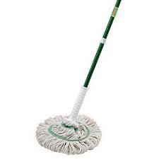
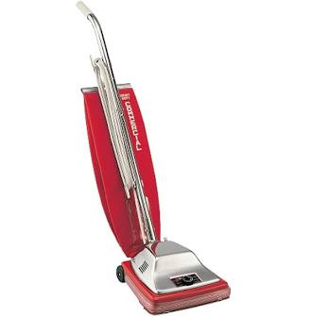
More verbs to practice…
To work = trabalhar I work, You work, He WORKS
To clean = limpar I clean, You clean, He CLEANS…
To wash = lavar **Todos têm o mesmo padrão
To organize = organizar He organizes
Broom
Mop
To mop
Vacuum
To vacuum

Slide 9
Practice with “To be”
I _____ a woman.
You “are” a tall man.
It “is” a nice day outside! He, she, it IS
He “is” from the United States.
We “are” young.
Why ARE you sad? Why IS she sad? “Why AM I sad?”
The brothers “are” five (5) years old.
Notes:
Do negatives (am not, etc) also

Slide 10
Practice with “To do”
I _____ exercise every day.
Where _____ you work?
My son _____ his homework (tarefa escolar).
We _____ our work together (juntos).
You all _____ a good job!
They _____ sports.

Slide 11
Practice with “To have”
I _____ two siblings.
Do you _____ children?
James _____ a big family.
We _____ a TV at home (em casa).
You all _____ a nice day!
My grandparents _____ eight (8) grandchildren.

Slide 12
“To have to”
Used to express obligation / Usado para expressar obrigação
Examples:
I have to work tomorrow.
You have to study (estudar).
John has to clean the house.

Slide 13
Practice with “To say”
I _____ “Hello” to my parents.
I do what you _____. (Eu faço o que você diz).
He _____ what he likes.
We say “Goodnight.”
Why do you all _____ mean things? (coisas rudes).
Do what they _____!
Notes:
Fewer bc not as many examples

Slide 14
Practice with “To go”
I _____ to school in Medford.
He _____ to work on Monday.
We _____ to the park (parque) to play soccer.
When do you all _____?
Emma and Grace _____ to the store.

Slide 15
You practice
Make sentences with these verbs / Forme frases com esses verbos
To be
To do
To have
To say
To go

Slide 16
More important verbs
To want = querer … I want to work.
To love = amar … I love my mother.
To like = gostar … I like sports.
To use = usar … I use a computer at school.
To watch = assistir … I watch TV at home.
To give = dar … I give my brother a banana.
To work = trabalhar … I work every day.
To need = precisar … I need water.
To make = fazer … I make a cake.
To sit = sentar… Sit down!
To take = tomar… My brother takes my money.
To understand = entender… Do you understand?
To think = pensar… I think soccer is fun.
To talk = falar… Sarah talks to John.
To read = ler… Do you like to read?
To sleep = dormir… My son sleeps a lot.
To eat = comer… When do you want to eat?
To drink = beber
Notes:
Every day = todos os dias Cake = bolo A lot = muito TO BE ABLE TO/CAN
Water = água Fun = divertido

Slide 17
Questions
We use the verb “To do” when forming questions
Em português você diz, "Quer comer?"
In English you say, “Do you want to eat?”
More examples:
Do you like to read? → Yes, I like to read.
Does he understand? → Yes, he understands.

Slide 18
Expressions
A lot
Many
A little
Few
Some
This
That
These
Those

Slide 19


Good job for today!

